Slide 1

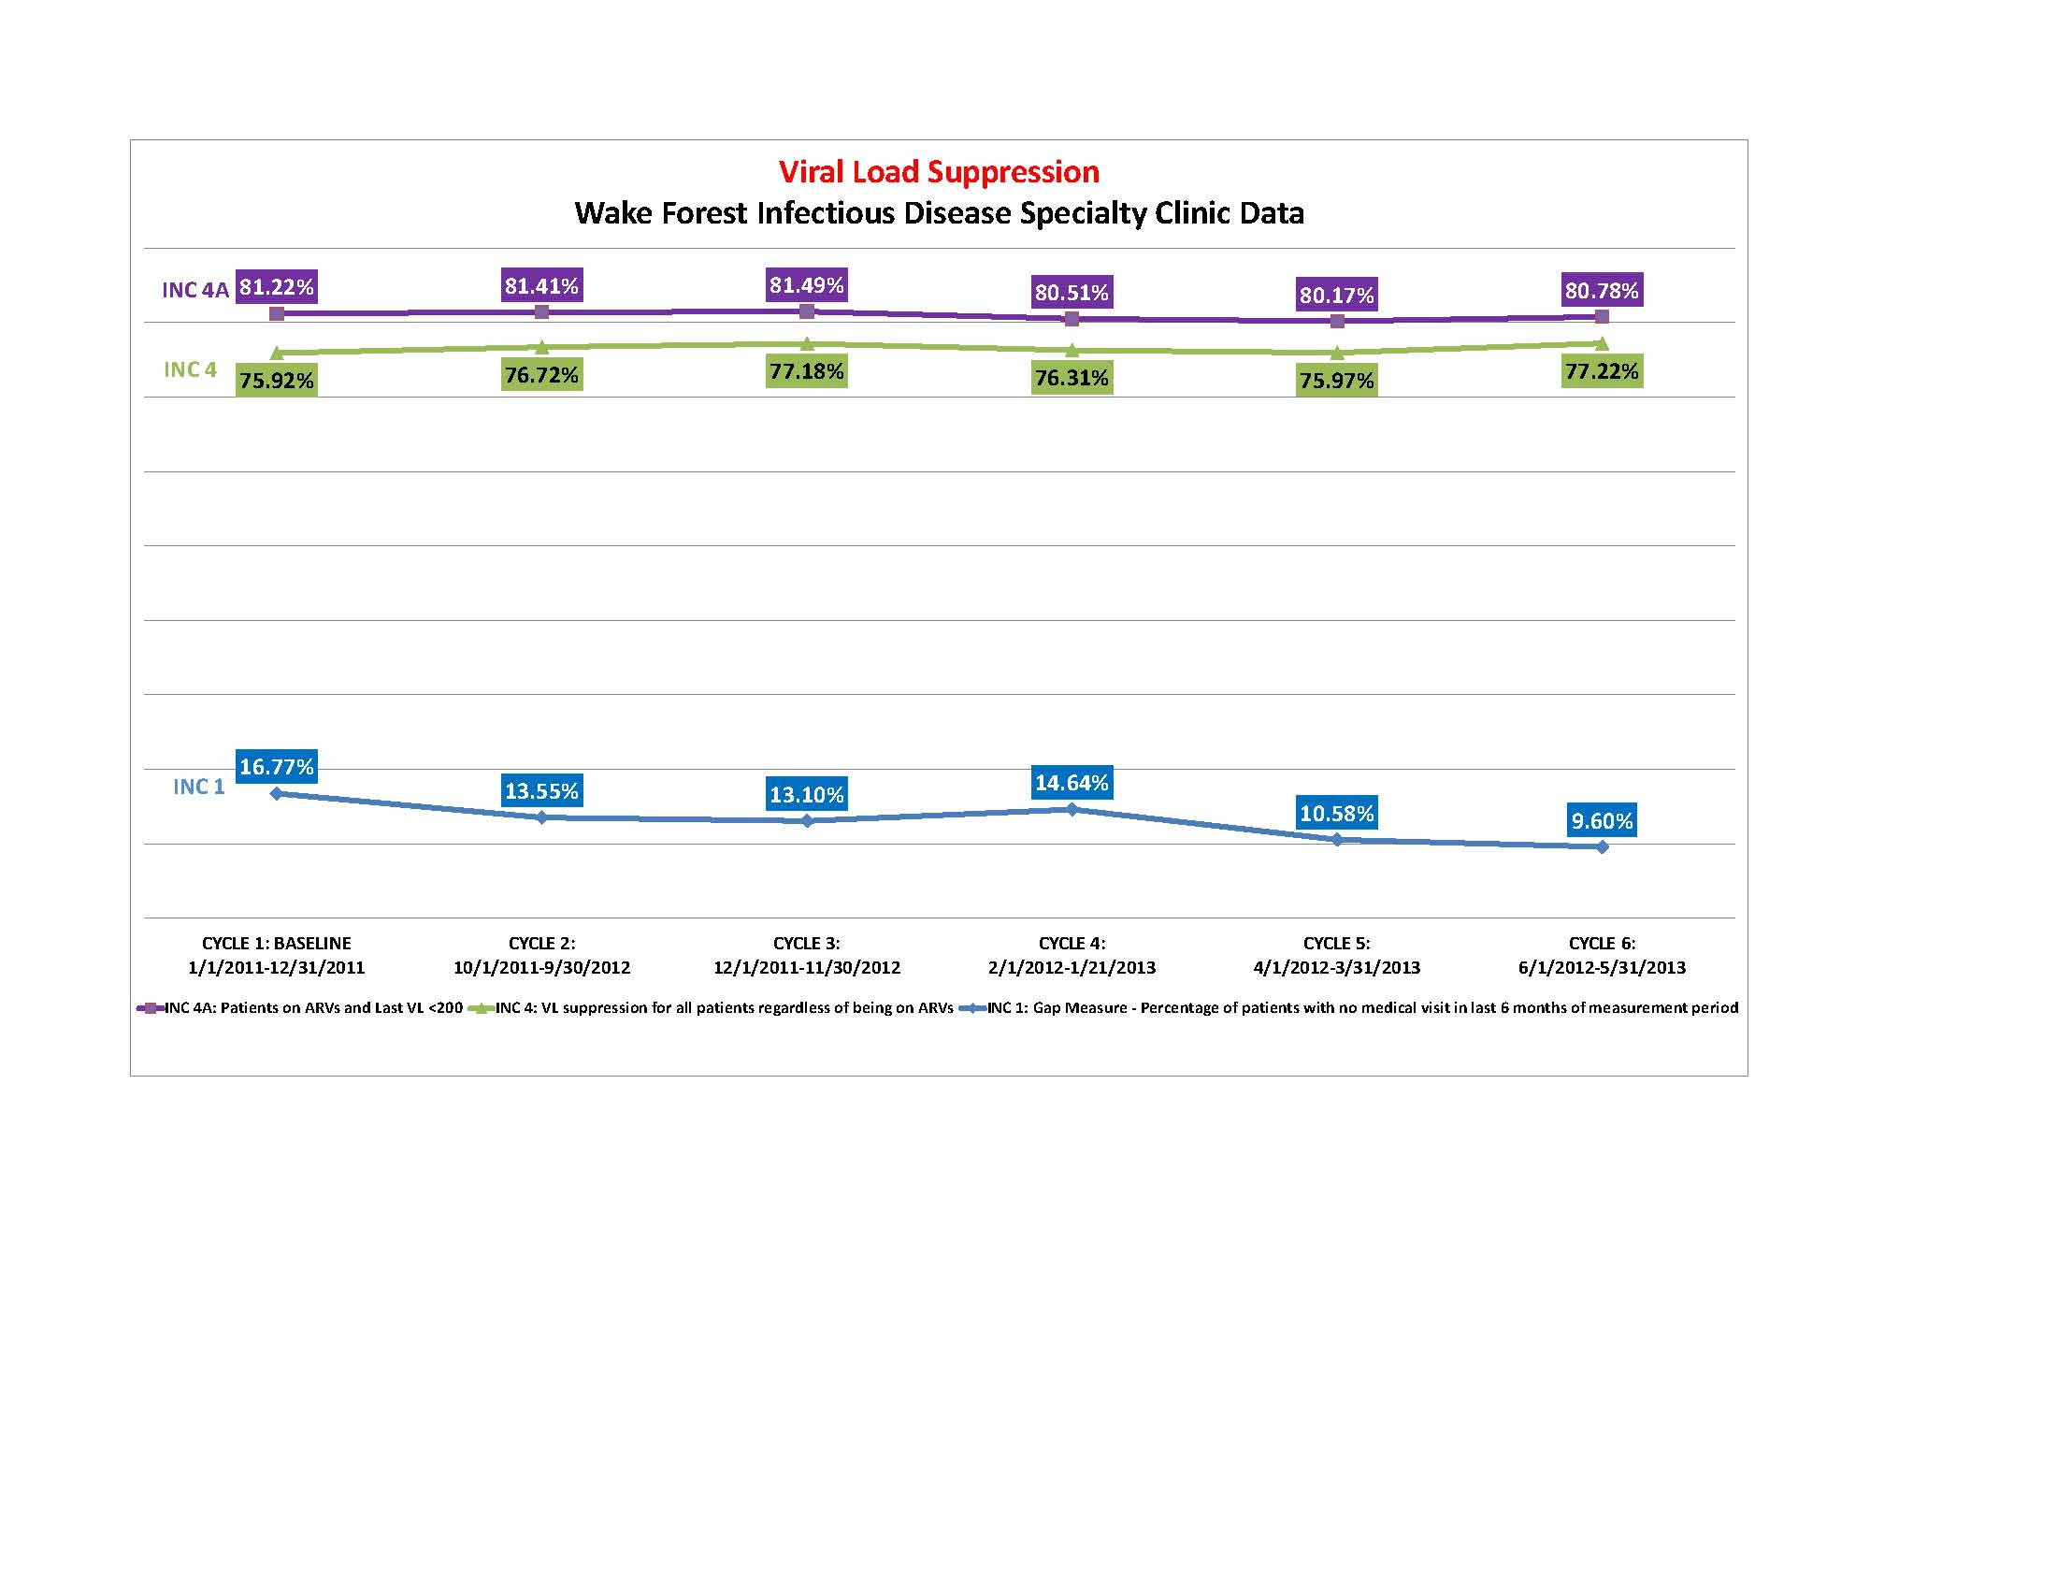
Viral Load Suppression Project Updates
Interventions/Updates Thus Far:
Monthly review of viral load suppression data at QI committee meetings
Review of total patient population data compared to population just on ARVs
Reviewing subsets of special populations (youth, women) to identify specific trends
Findings include lower rates of suppression in youth and minority women
Newly implemented Pharmacist Clinic (July 2013), secured Clinical Pharmacy Practitioner licenses
Goal: Use new pharmacy clinic to deliver intensive Tx adherence counseling services to chronically unsuppressed patients and provide more intensive counseling for new ARV starts
Also working on bridging retention efforts through NC LINK with viral load suppression project data reviews to identify most vulnerable out of care patients who are virally unsuppressed

