Slide 1

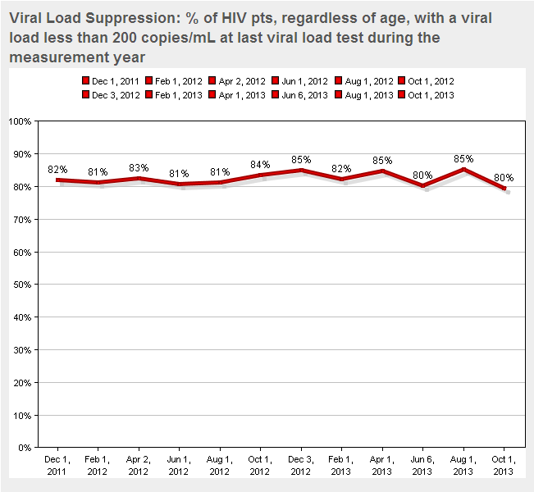
In+Care: Viral Load Suppression
Interventions:
1. Form a QI team to specifically address VLS
2. Utilize CAREWare to identify non-suppressed patients
3. Team creates a Fishbone diagram to identify
barriers to viral load suppression
4. Team categorizes patients by barriers to identify which
barriers impact VLS the most
5. Interventions are being tested with a PDSA for 5 of the
largest barriers to VLS
6. Consumers recruited and are actively involved with the PDSA
interventions
Interventions being tested:
Faster data entry into CAREWare
Follow up on patients new to HAART
Mental Health Barrier
Insurance Barrier
Improved communication between patients and staff

Slide 2
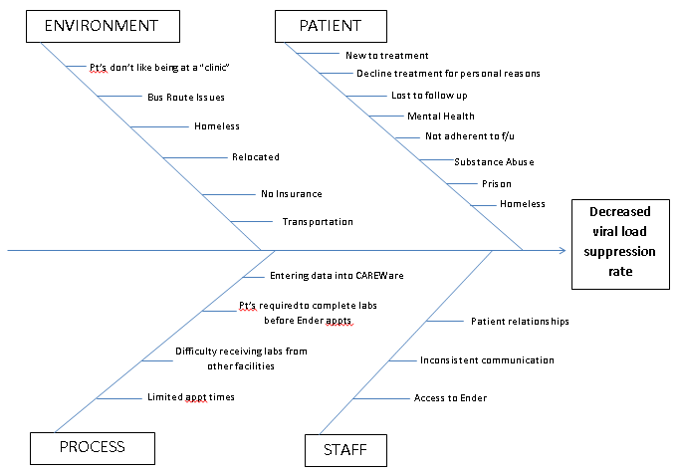
Barriers to Viral Load Suppression

Slide 3

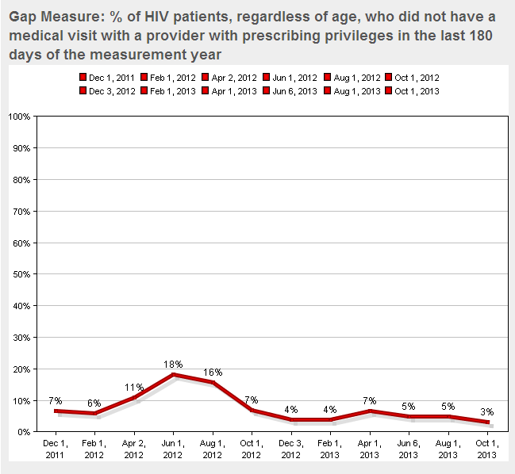
In+Care #1: Gap Measure
Interventions
Monthly case review of patients without a visit in 6 months (“FBI List”)
Assign team member tasks to contact and reel patients back into care.
As of September 2013, began sending closure letters at 6 months and warn of refill/treatment discontinuation.
Coming soon: Use of ARTAS (evidence-based intervention)
Other reasons for gap in care:
--mental health
--fear of bad news
--feeling good/don’t need to see doctor
--snow-birding
--meds continuously refilled with no consequences
No primary care provider between September 2011-July 2012.

