Slide 1

Partnering with Chinese Immigrant Religious Institutions to Raise HIV Awareness and Confront Stigma
HIV Quality Improvement Learning Network
New York City Health and Hospitals Corporation
Monthly Topical Conference Call
October 9, 2013
John J. Chin, Ph.D.
Associate Professor, Department of Urban Affairs and Planning
Hunter College, City University of New York
john.chin@hunter.cuny.edu

Slide 2
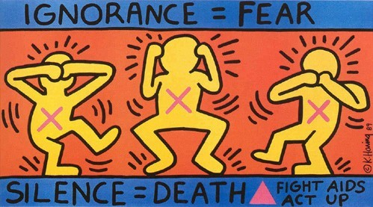

Slide 3


Notes:
http://www.actupny.org/YELL/stopchurch99.html
“In December of 1989, ACT UP made history with a massive protest at St.Patrick's Cathedral. Five thousand people protested the Roman Catholic Archdiocese's public stand against AIDS education and condom distribution, and its opposition to a women's right to abortion. On Sunday, December 12, 1999 at 9:45am, ACT UP went back at St. Patrick's for a press conference to commemorate the tenth anniversary of the demonstration and hand out condoms and safer sex literature to passer-bys. We returned to St. Patrick's because so little has changed in ten years. The issues are still the same.”

Slide 4

Notes:
http://blogs.medindia.net/2008/09/page/2/
September 2008: “A militant group combatting the spread of AIDS hung a banner across the facade of one of Paris’s most famous churches Saturday in a protest against Pope Benedict XVI’s visit to France. The banner on the Sacre Coeur basilica read “the condom is life,” in a reference to the Roman Catholic Church’s objections to the contraceptive device which also blocks the transmission of the AIDS virus.”
http://www.cathnewsindia.com/tag/hiv/
Korean women agree with pope on condoms
Published Date: November 26, 2010
“Catholic women leaders in Korea have welcomed Pope Benedict XVI’s view of the use of condoms in certain cases despite priests clarifying that the Church’s basic position remains unchanged.
Teresa Kim Sun-shi, former president of the Korean Catholic Women’s Community for a New World, said she feels “relieved” as she thinks the Church, which has “rigidly” opposed condom use, “has progressed a little.”
She said she is happy that the Church has seemingly stepped forward in the “understanding of the modern society and human beings.”
The issue came to light after the L’Osservatore Romano published the Pope’s comments on Nov. 20 in a book entitled, Light of the World: The Pope, the Church and the Signs of the Times, based on a series of interviews by a German journalist with Pope Benedict.
The pope reportedly said that condoms may be used by men and women sex workers, as it is a lesser evil than transmitting HIV.
Father Paul Lee Chang-young, executive secretary of the Korean bishops’ Committee for Bioethics, argued that the pope mentioned “an extremely exceptional case,” stressing the Church’s basic view on the condom has not changed.”

Slide 5
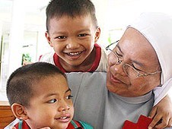
Notes:
http://www.cathnewsindia.com/2009/09/29/thai-nuns-battle-for-kids-with-hivaids/#
Thai nuns battle for kids with HIV/AIDS
Published Date: September 29, 2009
“A congregation of nuns is giving abandoned children with HIV the chance of an education and a normal life while fighting discrimination against them.
“Many people are afraid of the disease and do not want HIV-positive children to be in their society and schools,” said Camillian Sister Rungphet Phanvongsa.
The nun is head of Lorenzo Home, an orphanage her congregation runs for HIV-infected kids in Phanatnikhom, Chonburi province, southeast of Bangkok. “Many families abandon their children when they discover the children are HIV-positive,” the nun said.
Mothers who are HIV-positive can pass on the virus to their children during pregnancy. Lorenzo Home looks after such children, aged between 18 months and 15 years, from the eastern and central regions of Thailand.”

Slide 6

Notes:
Rick Warren, Saddleback Church; gave Obama’s inauguration invocation:
http://www.saddleback.com/aboutsaddleback/signatureministries/hivaidsinitiative/
“The HIV/AIDS Initiative at Saddleback was born out of the conviction that God cares about sick people – he loves people who are HIV-positive. A study of Scripture reveals a God who is passionate about the sick, the widow, the orphan, the immigrant, and the poor. Over and over he instructs the children of Israel to make provisions for them, treating them fairly and with compassion. Jesus spent one-third of his ministry healing the sick. There is no doubt in our minds that if Jesus was walking the earth today he would be with orphans, widows, and those living with HIV and AIDS. His heart was always with those ignored, neglected, or rejected by society.
Today, those with HIV and AIDS are often treated as outcasts, forcing them to hide even from family members out of fear or shame. It is likely that someone in your workplace or church is HIV-positive and you don’t know it. Because Jesus loved, touched, and cared for those who were sick, we must too. We care because God cares. We care because people matter to God and to us.
The global HIV and AIDS pandemic is the Church’s greatest opportunity to serve the hurting like Jesus did, to show God’s love to skeptics, to share the Good News, and to extend a helping hand in communities around the world. You have the opportunity to be the hands and feet of Jesus.
"You must be compassionate, just as your Father is compassionate” (Luke 6:36)”
http://totalbuzz.ocregister.com/2008/12/23/pastor-rick-warren-tries-to-clarify-position-on-gay-marriage/10828/
However, in the video Warren posted yesterday, he says:
Dec. 23, 2008:
“I’ve in no way ever taught that homosexuality is the same thing as a forced relationship between an adult and a child, or between siblings. I’m not opposed to gays having their partnership. I’m opposed to gays using the term marriage for their relationship….
“While I believe the gay view of sexuality is contrary to God’s word, I do believe that God gives us free choice. And he gives us the choice to obey his word or to disobey it.”

Slide 7
Public Policy Contexts
White House Office of Faith-based and Neighborhood Partnerships
Nonprofit Law:
Not required to apply for tax-exempt status
Not required to file IRS 990 Form
Religious Land Use and Institutionalized Persons Act (RLUIPA)
Increasing presence of evangelical grassroots movements in politics
Religion’s impact on HIV/AIDS policy
Notes:
Increasing presence of evangelical grassroots movements in politics, starting in 1980s (according to Putnam)
RLUIPA: “No government shall impose or implement a land use regulation in a manner that imposes a substantial burden on the religious exercise of a person, including a religious assembly or institution, unless the government can demonstrate that imposition of the burden…is in furtherance of a compelling governmental interest…”

Slide 8
Background:
Asian American Population and HIV/AIDS Epidemiology

Slide 9
Asian Population
Asian population growth in NYC
71% between 1990 and 2000
32% between 2000 and 2010.
More than one million Asians in NYC in 2010 (about 13% of NYC’s total population).
Notes:
Data derived from analysis by the Asian American Federation Census Information Center
1990: 509,955
2000: 872,777 (Asian alone or in combination)
2007: 1,046,082 (Asian alone or in combination)

Slide 10
Asian Population
45% of Asians in NYC are Chinese.
72% of the Asian population in NYC is foreign-born.
http://www.aafny.org/cic/briefs/nycbrief2006.pdf

Slide 11
Asians and HIV in the US
HIV/AIDS prevalence relatively low, but signs of rapid increase.
Between 2001 and 2004, Asians had the only statistically significant increases in HIV/AIDS diagnosis rates in the US.
In the same period, NYCDOH reported that in NYC “the number of new HIV diagnoses each year has declined in all racial/ethnic groups except Asian/Pacific Islander.”
Chin JJ, Leung M, Sheth L, Rodriguez TR. Let's Not Ignore a Growing HIV Problem for Asians and Pacific Islanders in the U.S. (2007). Journal of Urban Health. 84(5):642-7.

Slide 12
HIV/AIDS in the Asia
AIDS has reached epidemic proportions in parts of Asia, home to 60% of the world’s population.
Approximately 4.7 million people living with HIV in 2008
New annual HIV infections decreased:
400,000 in 2001
350,000 in 2008

Slide 13
Guiding Questions
Are religious institutions good partners in promoting HIV awareness and reducing stigma?
Can they support the best scientifically supported approaches to HIV prevention?

Slide 14
New York City
New Reported HIV Diagnoses: Race by Year
 | 2011 | 2010 | 2009 | 2008 | 2007 | 2006 | 2005 | 2004 | 2003 | 2002 | 2001
API | 105 | 101 | 118 | 123 | 133 | 91 | 111 | 98 | 81 | 89 | 89
Black | 1565 | 1675 | 1839 | 2070 | 2030 | 2037 | 2202 | 2160 | 2386 | 2728 | 3040
His-panic | 1088 | 1075 | 1229 | 1278 | 1303 | 1318 | 1265 | 1231 | 1347 | 1427 | 1665
White | 640 | 669 | 665 | 693 | 725 | 690 | 716 | 688 | 742 | 833 | 875
Native Am. | 1 | 5 | 14 | 18 | 15 | 17 | 13 | 9 | 9 | 5 | 7
Other/ Unk. | 5 | 7 | 3 | 4 | 2 | 4 | 8 | 0 | 5 | 9 | 8
Notes:
http://www.nyc.gov/html/doh/html/data/hivtables.shtml
[reports downloaded on 9/26/2013]

Slide 15
New York City, API
There were 1,936 APIs “known” to be living with HIV/AIDS in NYC, at end of 2011, compared to 803 at the end of 2001, an increase of 141% over the 10-year period.
Notes:
http://www.nyc.gov/html/doh/html/data/hivtables.shtml
[reports downloaded on 9/26/2013]

Slide 16
Background:
HIV Stigma in Asian American Communities

Slide 17
Stigma and Isolation
High level of perceived stigma. Perception that Asians are more un-accepting than other groups.
Some cases show that it is possible to tell friends and family and get support.
Other experiences are very negative.
Notes:
17

Slide 18
Mental health
Because of isolation, many respondents spoke of being sad, lonely or anxious.
71% of APIs had low or very low mental health scores, compared to 50% for other New Yorkers with HIV.
Notes:
18

Slide 19

APICHA – Asian and Pacific Islander Coalition on HIV/AIDS (NYC)

Slide 20


Banyan Tree Project

Slide 21
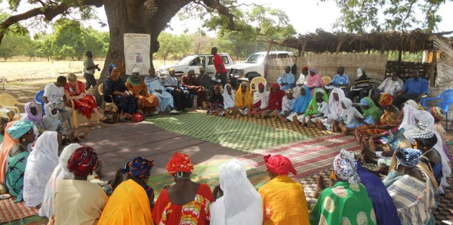
The Grandmother Project
Notes:
http://www.grandmotherproject.org/
“Grandmother Project builds on the knowledge and experience of grandmothers and elders
Elders are respected In all non-Western societies for their experience and the support and guidance they provide to younger generations. Grandmothers play a special role teaching and caring for children and women. GMP views grandmothers as an ignored resource and explicitly involves them as key actors in all development programs.”
“The Grandmother Project grew out of a series of successful experiences involving grandmothers as resource persons in community health programs in Laos, Sengal, Mali, Uzbekistan, Albania, and Mauritania.”

Slide 22
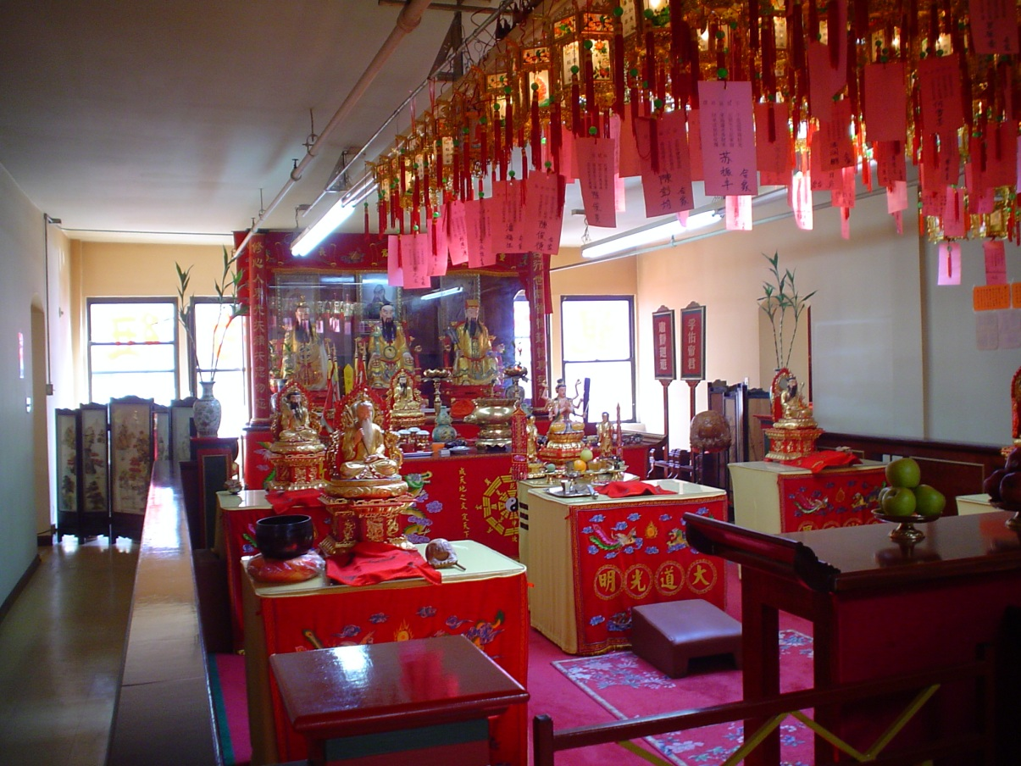

Slide 23
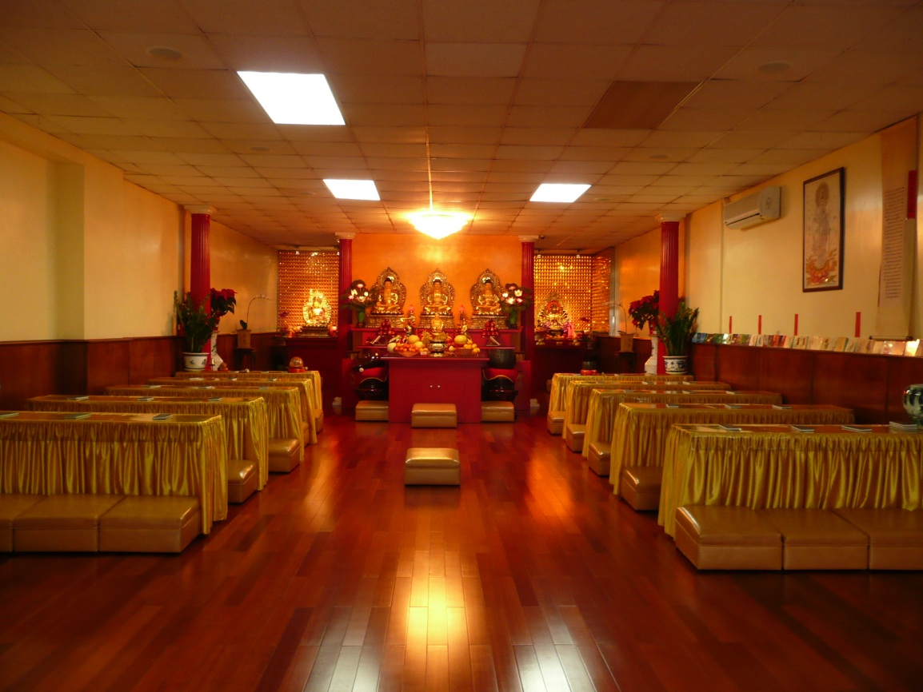

Slide 24
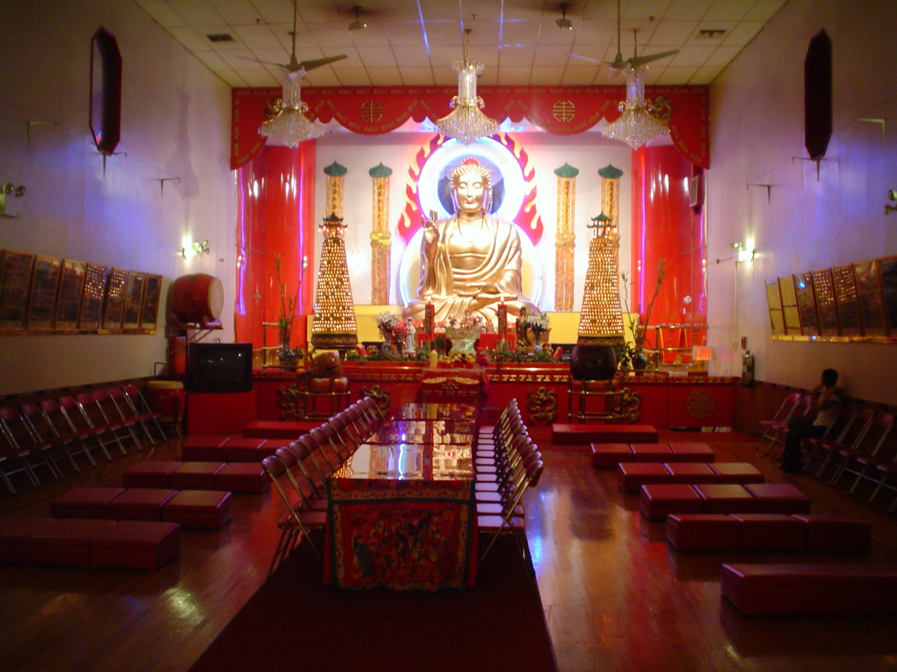

Slide 25
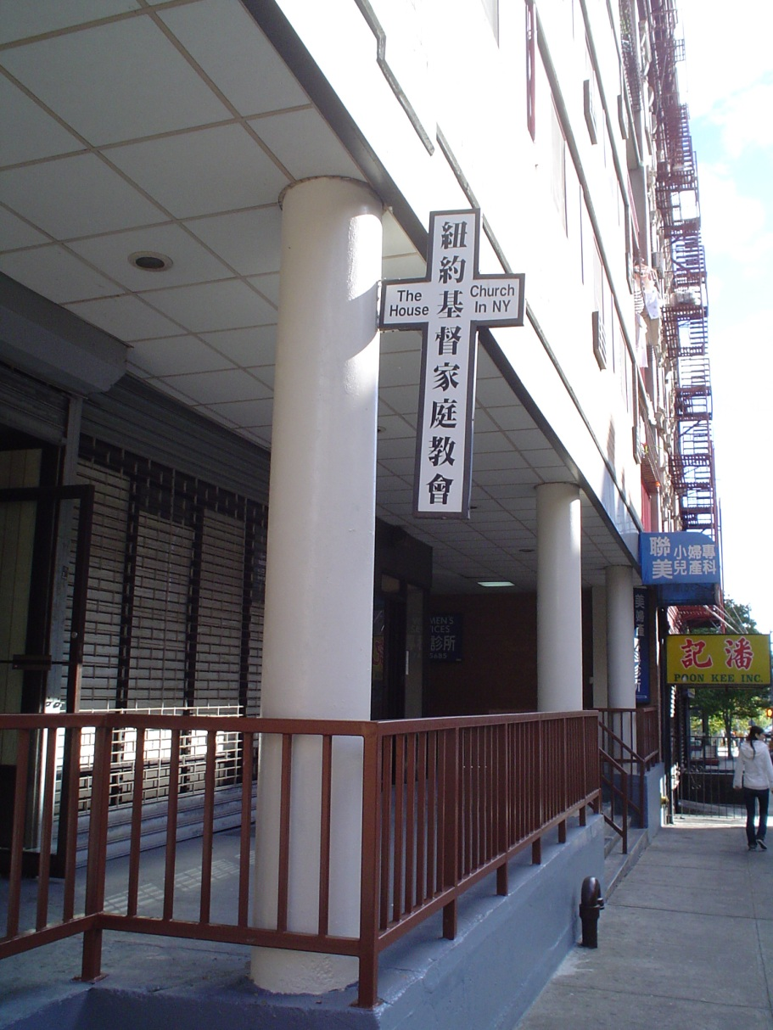

Slide 26
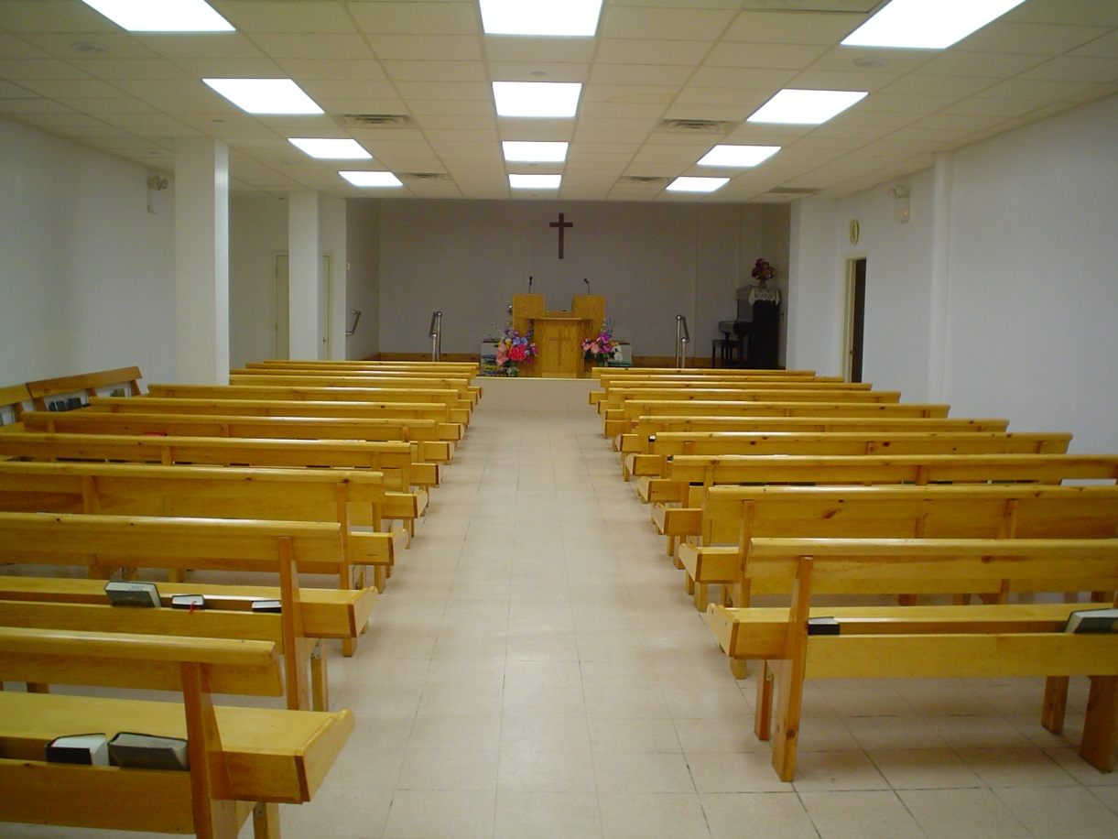

Slide 27
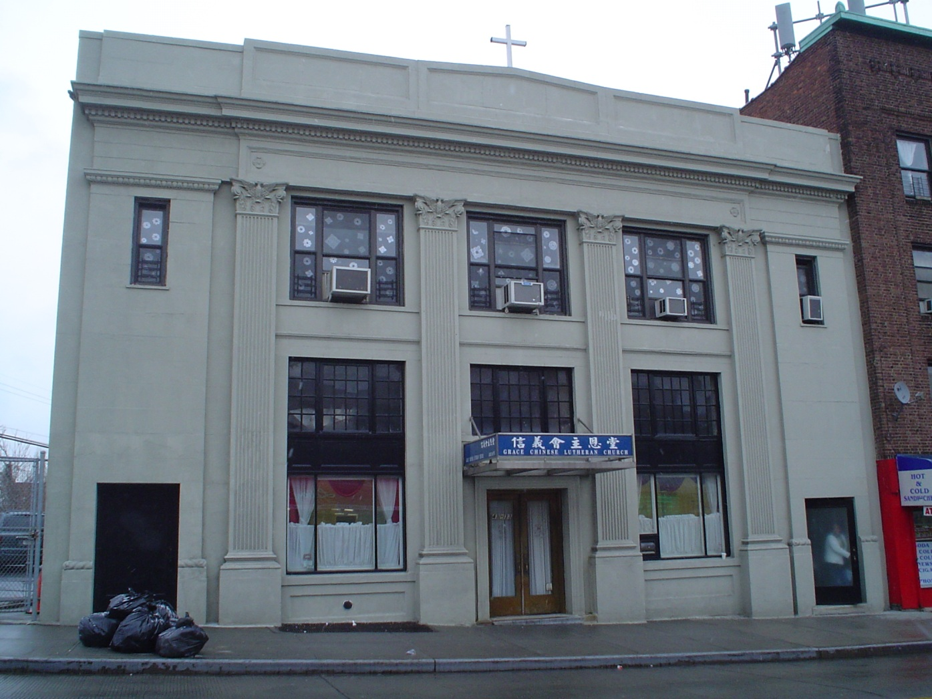

Slide 28
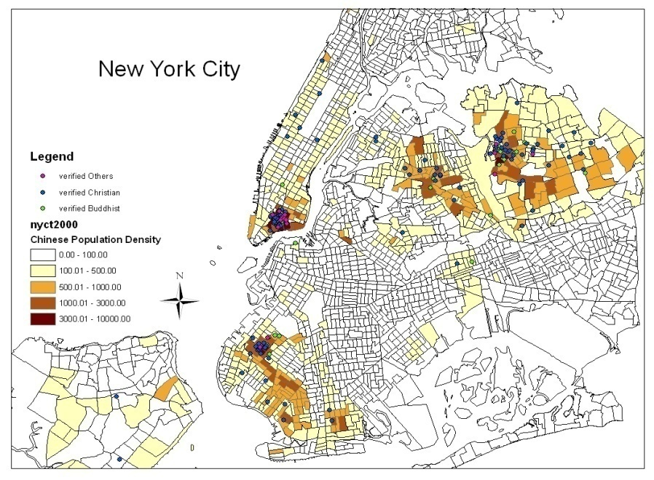
Notes:
28

Slide 29
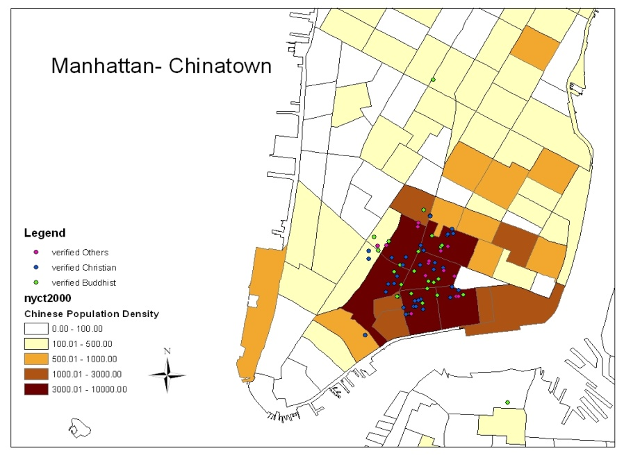
Notes:
29

Slide 30
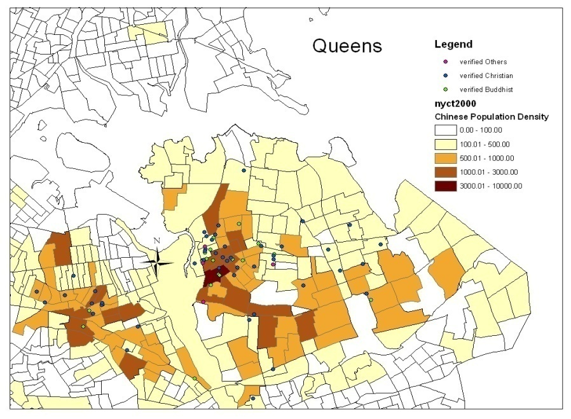
Notes:
30

Slide 31
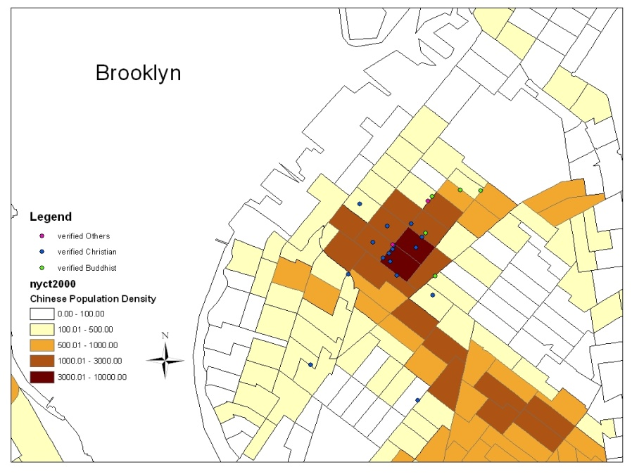
Notes:
31

Slide 32
Involvement in HIV and Health

Slide 33
Image/Reputation Concerns
I: How do you think other people in your temple would feel about the temple being involved in activities with an AIDS focus? Who would approve or who would oppose? ….
R: …we would be absolutely supportive and cooperative…
I: How about other people in the community, Chinatown, do you feel your temple’s involvement in an AIDS-related educational or supportive program in the future would change their perception of this temple?
R: I haven’t thought about it, but I don’t think so. Because we…If we were to use our own name, then it may not be okay, but as long as we participate in activities done by outsiders, then it should be no problem.”
Notes:
33

Slide 34
Fear of Difference
“we’re not ready to have these different social groups come, lower class, or troubles or issues the church will not be ready for. I guess, [our church members] don’t know how to maybe care for them, and in a way, it could be problematic to have their kids mix with our kids, so there is a lot, some fears already, about influence and culture already.”
Notes:
34

Slide 35
Homosexuality
“just like any other thing that God sees as sin, …thou should not murder, thou should not steal, thou should not lie, the Bible is very strict … that you should have no immoral relationship …with men and men, women and women.”
“Of course we say homosexuality is not favored by God…In the Book of Romans, it’s said that the things between the same gender are shameful things, God does not like them, and they would get the justified retribution.”

Slide 36
Homosexuality
“Some people will say men being with men, women being with women, then it will cause chaos. I don’t believe that will cause chaos…I don’t think it’s wrong, since it’s only the very few.”
“I know what the Bible says and what the church teaches. But I have an uncle who is gay and I love him. I just wish the church would build bridges instead of burning them.”

Slide 37
HIV Knowledge

Slide 38
HIV/AIDS Attitudes: Worry & Stigma

Slide 39
HIV/AIDS Attitudes: Support & Awareness

Slide 40
Views on Organizational Involvement

Slide 41
HIV Workshop Topics

Slide 44
The Stigma Challenge
What can we do to eliminate stigma as a factor in increasing HIV risk, creating barriers to care, and contributing to poor mental health and isolation among people living with HIV/AIDS?
How can we motivate our communities’ leaders to speak out against HIV stigma?
Should public policy encourage religious institutions’ involvement in HIV/AIDS education?

