Slide 1

Lightning Round!
NC RQC Meeting
August 9, 2013

Slide 2
Instructions
Create 1 slide to cover the following:
Agency name
List the performance measure
Show trend data for the performance measure over time
Delineate the interventions/PDSA cycles implemented
Share data related to impact of the interventions
How do you know the intervention/test of change worked?
Examples are provided, but feel free to use your own style

Slide 3

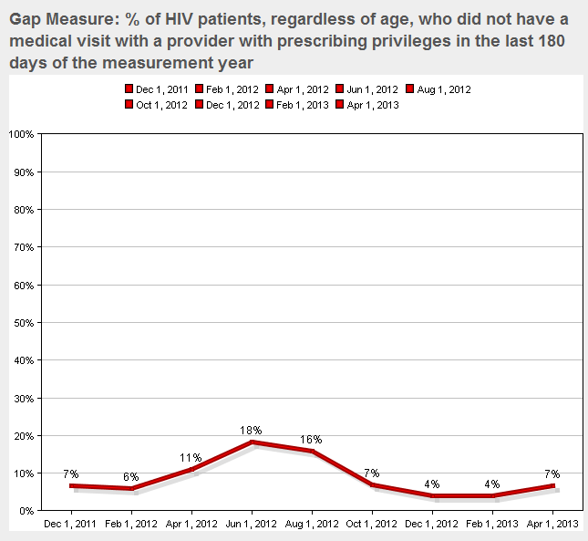
In+Care #1: Gap Measure
Interventions
Monthly case review of patients without a visit in 6 months (“FBI List”)
Assign team member tasks to contact and reel patients back into care.
Drafted a closure letter to send at 6 months and warn of refill/treatment discontinuation.
Coming soon: Use of ARTAS (evidence-based intervention)
Other reasons for gap in care:
--mental health
--fear of bad news
--feeling good/don’t need to see doctor
--snow-birding
--meds continuously refilled with no consequences
No primary care provider between September 2011-July 2012.

Slide 4

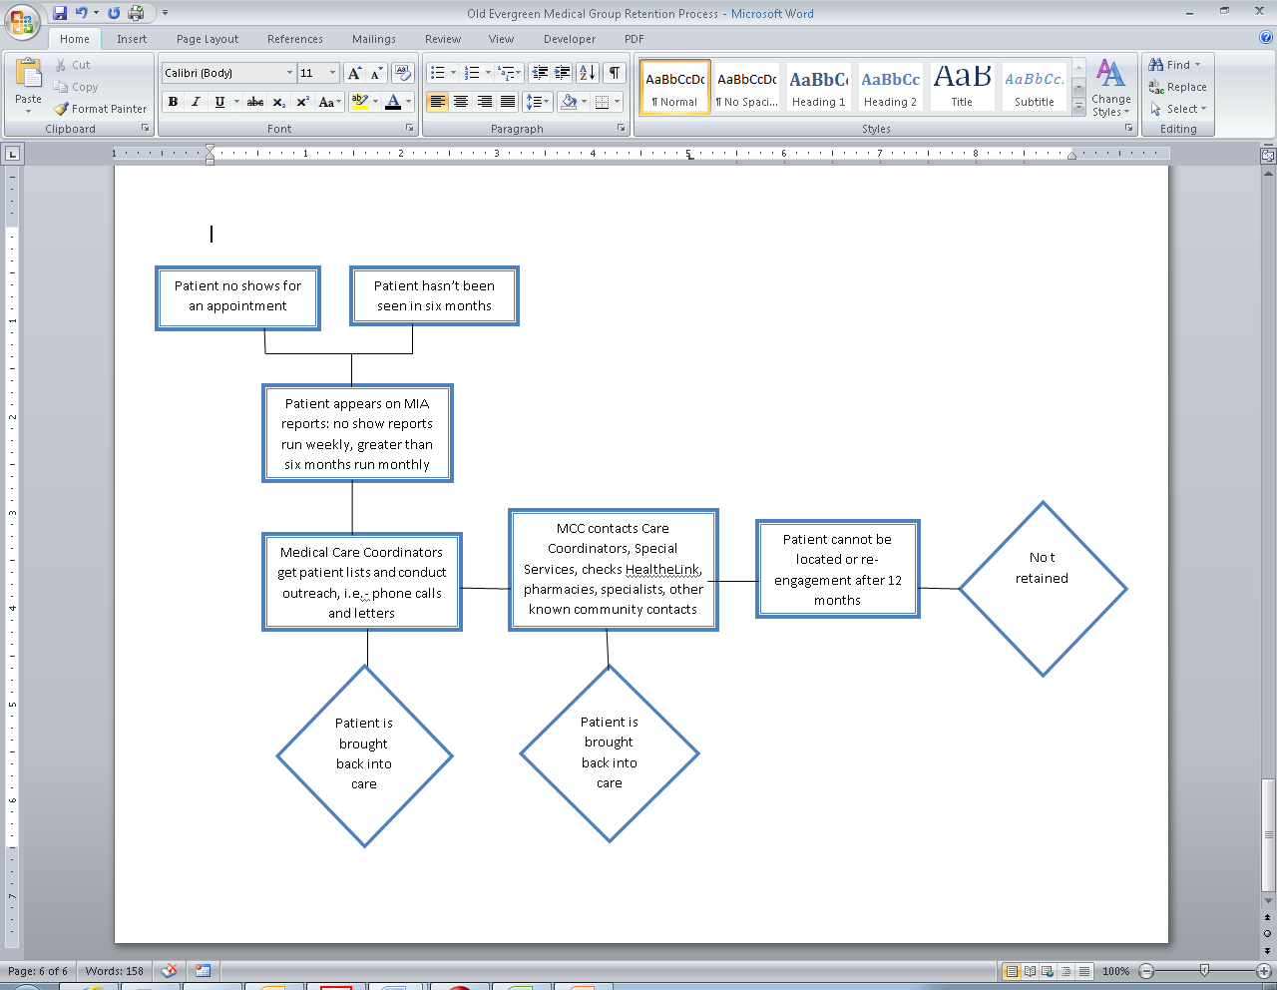
Improving the Rate for New HIV+ Patient Retention
New Retention Flow Chart
Background:
The National AIDS Strategy and CDC High Impact Prevention Strategy require linkage and retention in HIV primary care to facilitate viral load suppression and prevention with positives.
New HIV+ Pt Retention rate average 75% for 2012.
Staff, space, and systems undergoing substantial changes.
Number of new pts increasing rapidly.
Interventions Utilized:
Redesign Medical Care Coordination # of pts, data clean up
Attention paid to retention rate.
Create new flow chart for all missed appts and pts not retained
Work with in house HIV/STI screening in relationship -building
Increase # of Medical Providers (done due to increased pts)
Results:
Increased Retention Rate by almost 10%.
New pt /mo doubled.
To continue to monitor over the next year.

Slide 5
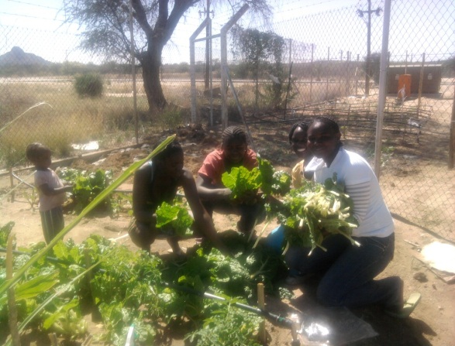
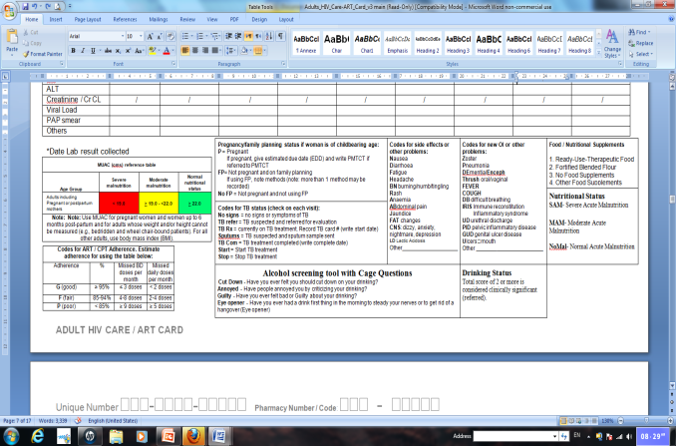
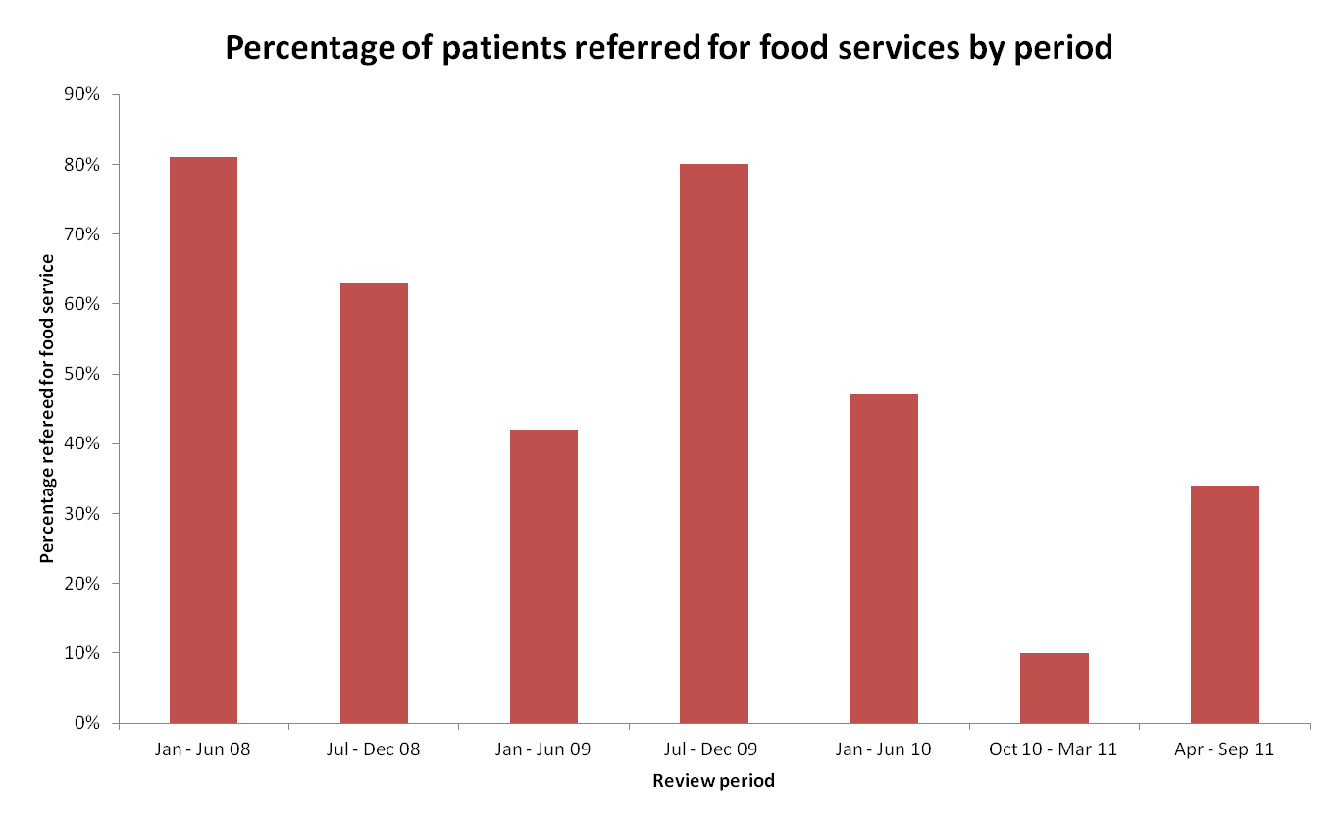
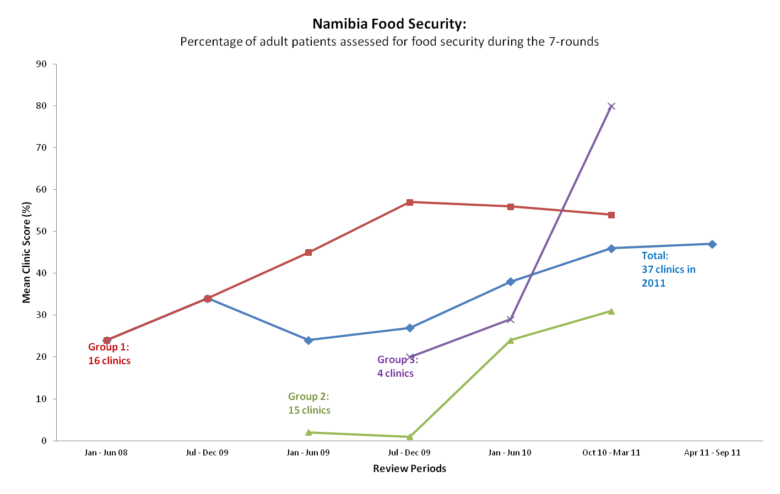
NAMIBIA: A Tale of Improving Food Security
INTERVENTIONS
Training of HCWs on importance of issue & measuring
Health education to patients/clients (specifically on alcohol abuse )
Devise basic, simple food security screening tools
Improve documentation system
Reorganize patient flow to streamline assessment
Identification of focal person to conduct assessments
Referrals, documentation/follow-up of patients needing food supplementation to NGOs
Arrange effective referral system
Introduction of NACS (Nutritional Assessment Counseling and Support) programme Nationwide.
Strengthen integration of social workers into care teams to assess food security
Initiation of nutrition gardens
Soup kitchen corners (nutritional education)
Initially lack of screening tool in the HIV patient care booklet
Poor documentation /lack of proper referral mechanism
No support groups address food security
Staff turnover and high workload
High national unemployed rate/poverty
Alcohol abuse

Slide 6
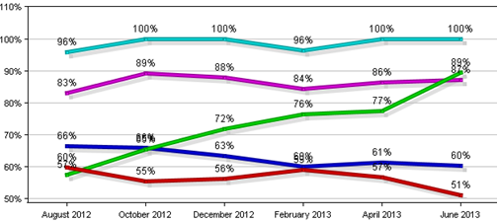
ECMC: Patients Newly Enrolled in Medical Care – August 2012 through June 2013
 |  | Aug-12 | Oct-12 | Dec-12 | Feb-13 | Apr-13 | Jun-13
National | %=mean | 60% | 55% | 56% | 59% | 57% | 51%
In+Care | n=patients | 7,687 | 8,335 | 8,476 | 8,014 | 5,857 | 5,619
 | p=organizations | 184 | 180 | 173 | 171 | 153 | 135
ECMC | %=mean | 57% | 65% | 72% | 76% | 77% | 89%
 | n=patients | 47 | 49 | 39 | 38 | 31 | 28
 | p=organizations | 1 | 1 | 1 | 1 | 1 | 1
NYS | %=mean | 66% | 66% | 63% | 60% | 61% | 60%
 | n=patients | 961 | 1,064 | 1,063 | 931 | 762 | 622
 | p=organizations | 15 | 14 | 14 | 13 | 12 | 11
Top 10% | %=mean | 96% | 100% | 100% | 96% | 100% | 100%
 | n=patients | 122 | 64 | 63 | 138 | 88 | 72
 | p=organizations | 19 | 18 | 18 | 18 | 16 | 14
Top 25% | %=mean | 83% | 89% | 88% | 84% | 86% | 87%
 | n=patients | 1,007 | 567 | 666 | 1,139 | 697 | 481
 | p=organizations | 46 | 45 | 44 | 43 | 39 | 34
Challenge | Intervention
Intake and follow up process/protocol was uniform for all patients entering care. | Immediately identify any need for additional support and refer to WICY team for intensive multi-disciplinary management.
After intake, patients worked with the case manager on call at time of visit or phone contact, with no protocol promoting consistency/continuity. | Devised system by which patients would immediately be linked with a consistent medical case manager, creating a treatment team with the medical provider.
Patient reminders were done manually by phone and inconsistently completed due to staffing. | Invested in automated system that allows patients to choose text or voice reminders and to confirm receipt of call. Reminders are made regardless of staffing.
HIV+ patients newly enrolled with a medical provider with prescribing privileges who had a medical visit in each of the 4-month periods in the measurement year improved from 57% in August 2012 to 89% in June 2013, entering the top 25% for In+Care and the top 10% for New York Links at same time national and state averages remained stagnant or decreased.

Slide 7
LVH.AAO. Annual Cervical Cancer Screening QI Projects
1st Year QI Project – Multi-discplinary Team
Baseline: 2011 – 54%
Interventions Tested – PDSA 1
Reminder Alerts for Provider in EMR that Pap is due
Sign ROI if done elsewhere
Result: Providers reported Alerts were helpful.
Interventions: PDSA 2
F/up letters for No shows and past due
F/up calls 2 weeks later to those who did not call
Schedule appt same day as PC visit
Designate one Friday/month w CWM
Results:
52% clients due had a sched appt
47% kept appt
53% no showed
Interventions made no difference.
PDSA 3
Will accept walk-ins at CWM; special time slots
Gift card
Hdout:”Why Should I have my Pap” and poster in exam room
Results: No improvement.
Findings: More gyn appts were scheduled; incentives did not work; reminder calls –no difference
Continue: Care Alerts, staff reinforcing importance of annual Paps; Waiting for approval for NP in ID clinic
2nd Year QI Project- Multi-disciplinary Team
Baseline: 2012 – 52%; 1/1/13 – 275 active Female patients
Survey results: 1st Pap Experience - scary, hate it, horrible
Aver age of 1st pap: 19.6 years
Client suggestions: buddy system, at AAO/HIV clinic, women doctors
Interventions Tested – PDSA 1
Incentive - $15.00 gift card
Staff will “talk it up”
Result:
30% who were due had a Pap in 1st quarter
(41/138)
Of the 30% who had a PAP: 14% received a $15. gift card; 32% completed the survey.

Slide 8
Wright Primary Care Center, Cervical Cancer Screening QI , 8/2012 Covers 7-County Area in NE PA, Multi-Disciplinary Team
2006
Baseline: 14%
Intervention: Internal focus
Results: 27%
2007
Baseline: 27%
Interventions:
Staff education
NP hired to focus on women’s health
Day designated for women’s wellness
Focus on women returning for annual Wellness Visit
No woman left the clinic w/o a woman’s health exam
2007 – Year 1
Results:
27% - 58%
Women’s Wellness
Women’s Health Visit
Combined with HIV medical visit
Pap and Pelvic Plus
STD screening
Breast Cancer Prev and Screening
Colorectal Cancer Screening
Osteoporosis Prev
Smoking Cessation Counseling
DV Screening
Secondary Prev
Med Adherence
Focus: Wellness
Patients as Partners
Team effort
2008 – Year 2
Inteventions:
Contd staff ed’n
“Spa bags” as gifts for patients (by staff and volunteers
Results: 73% with an increase in number of patients
2009 – Year 3
Sustaining interventions
Results: 74%
Barrier to achieving higher rates:
Retention
2010: 148 active Female patients
Then lost NP.

