Slide 1
Harlem ID Clinic QI
Viral Load Suppression
Harlem Hospital Center
Michael Serlin, MD
Medical Director, Harlem Family Center
October 9, 2013

Slide 2
New QI Project –
VL Suppression
Already monitoring through in+care campaign
Goal of patients on ARVs to have an undetectable viral load
  DHHS and NYC DOHMH recommend all patients to be on ARVs
Several barriers to having suppressed viral load:
  Nonadherence / diversion / denial
  Mental health / substance abuse
  Family / insurance / housing / incarceration
Goal of project is to increase those who have undetectable viral loads by 10%

Slide 3
Process to detectable VL
Patient – unsatisfied with PCP; health beliefs; not in care; drugs/EtOH; diversion/$$; no PCP; Ψ; housing/SW; insurance
Labs – VL not drawn / processed; genotype / integrase resist. not done
Meds – pharmacy / PA# not done;
no insurance; copay/$; refills not done
Providers – Unclear PCP; wrong PCP;
not aware high VL; not aware patient not in care
High VL
Staffing – wrong contact info;
no reminder phone call;
unaware patient out of care

Slide 4
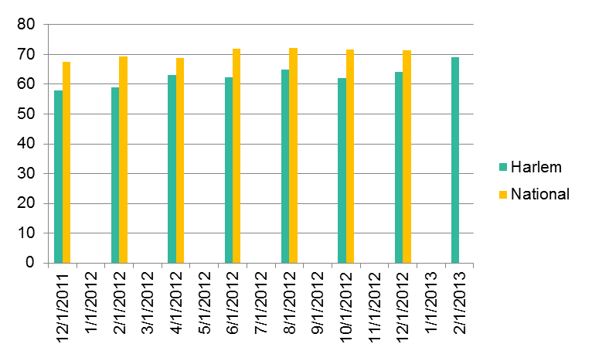
Viral Load Suppression
% of HIV pts, regardless of age, with a viral load less than 200 copies/mL at last viral load test during the measurement year

Slide 5
New QI Project –
VL Suppression
Revamping of Thursday Weekly Care Coordination meetings to be more provider-centric
Updating Census to include last visit/annual/viral loads, and distributing to each provider
Giving cards with CD4/Viral load log to patients so they can keep track of own progress (if they want)
For those with ↑ VL, providers should address why that is, and what their intervention may be, document in chart
  Discussion of various programs and opportunities for patients to become more adherent.
  Outreach to those who may have fallen out of care
Periodical morning sessions/ brown bag lunch with providers to discuss difficult cases

Slide 6
Census with last visits, annuals, and VL
Patient First Name | Patient Last Name | Medical Record Number | Gender | BIRTHDATE | Age | Last Annual | Last Visit | 1st Outreach attempt | Last VL | VL Value
 |  |  | Male | Xx-xx-xxxx | 53 | 13-Dec-2012 | 21-Mar-2013 |  | 21-Mar-2013 | HIV-1 RNA not detected
 |  |  | Female | Xx-xx-xxxx | 49 | 26-Apr-2012 | 23-Aug-2012 | needs outreach | 23-Aug-2012 | 1.66E+3 copies/mL
 |  |  | Male | Xx-xx-xxxx | 44 | 21-Mar-2013 | 21-Mar-2013 |  | 3-May-2013 | 163
 |  |  | Male | Xx-xx-xxxx |  |  | 5-Sep-2012 | needs f/u, initial | 5-Sep-2012 | 6.65E+3 copies/mL
 |  |  | Male | Xx-xx-xxxx | 58 | 13-Sep-2012 | 14-Feb-2013 |  | 27-Feb-2013 | HIV-1 RNA detected <2.00E+1 copies/mL
 |  |  | Male | Xx-xx-xxxx | 58 | 26-Jan-2012 | 7-Mar-2013 |  | 25-Oct-2012 | HIV-1 RNA not detected
 |  |  | Male | Xx-xx-xxxx | 51 | 19-Feb-2012 | 25-Oct-2012 | needs f/u | 20-Jul-2012 | <20
 |  |  | Female | Xx-xx-xxxx | 47 | 19-Apr-2012 | 6-Dec-2012 | needs outreach | 6-Dec-2012 | 5.71E+4 copies/mL
 |  |  | Male | Xx-xx-xxxx | 48 | 12-Apr-2013 | 12-Apr-2013 |  | 31-Mar-2013 | 334000
 |  |  | Female | Xx-xx-xxxx | 31 | 24-Jul-2012 | 21-Mar-2013 |  | 28-Mar-2013 | HIV-1 RNA detected <2.00E+1 copies/mL
 |  |  | Female | Xx-xx-xxxx | 52 | 27-Sep-2012 | 28-Mar-2013 |  | 28-Mar-2013 | HIV-1 RNA not detected
 |  |  | Male | Xx-xx-xxxx | 24 | 17-Jan-2012 | 14-May-2012 | needs outreach | 22-Mar-2012 | 78

Slide 7
Results from initial eval (6/12)
Provider | Patients | Seen <6 months | needs outreach | last VL <200 | last VL >200 | >200, outreach | not in care here | not in care, vl <200 | % <200
A | 43 | 39 | 2 | 38 | 5 | 0 | 1 | 1 | 88.1%
B | 10 | 10 | 0 | 8 | 2 | 0 | 0 |  | 80.0%
C | 51 | 41 | 11 | 34 | 17 | 3 | 0 |  | 66.7%
D | 47 | 33 | 10 | 34 | 10 | 4 | 3 |  | 77.3%
E | 26 | 24 | 2 | 19 | 7 | 2 | 0 |  | 73.1%
F | 55 | 41 | 12 | 41 | 13 | 7 | 1 |  | 75.9%
G | 34 | 25 | 6 | 33 | 1 | 1 | 3 | 3 | 96.8%
H | 84 | 72 | 8 | 73 | 11 | 3 | 4 | 2 | 88.8%
I | 183 | 157 | 19 | 125 | 58 | 10 | 7 | 3 | 69.3%
J | 46 | 39 | 5 | 35 | 11 | 1 | 2 | 1 | 77.3%
K | 66 | 56 | 8 | 49 | 16 | 3 | 2 |  | 76.6%
L | 79 | 70 | 7 | 58 | 20 | 4 | 1 |  | 74.4%
M | 45 | 37 | 7 | 37 | 8 | 2 | 1 |  | 84.1%
N | 54 | 42 | 9 | 39 | 15 | 3 | 2 | 2 | 71.2%
Totals | 823 | 686 | 106 | 623 | 194 | 43 | 27 | 12 | 76.8%
Outreach Result Provider → | A | B | C | D | E | F | G | H | I | J | K | L | M | N | total
tele no invalid/ unlisted | mail sent | 2 | 0 | 4 | 4 | 0 | 4 | 3 | 5 | 7 | 1 | 4 | 4 | 3 | 2 | 43
VM X2+ | mail sent | 0 | 0 | 7 | 3 | 2 | 2 | 1 | 4 | 7 | 3 | 3 | 2 | 4 | 4 | 42
at another hospital/clinic | 0 | 0 | 1 | 1 | 0 | 2 | 2 | 1 | 2 | 0 | 0 | 0 | 0 | 1 | 10
Pt. recently visited/ have an upcoming appt. | 0 | 0 | 2 | 1 | 0 | 1 | 0 | 0 | 1 | 0 | 0 | 0 | 0 | 1 | 6
want to set up an appt. | 0 | 0 | 0 | 1 | 0 | 1 | 0 | 0 | 1 | 0 | 0 | 0 | 0 | 0 | 3
other reasons i.e. deceased, insurance issue, work schedule conflicts, etc. | 0 | 0 | 0 | 1 | 0 | 3 | 0 | 0 | 1 | 2 | 1 | 0 | 0 | 1 | 9
Total outreach | 2 | 0 | 14 | 11 | 2 | 13 | 6 | 10 | 19 | 6 | 8 | 6 | 7 | 9 | 113

Slide 8
VL Suppression:
Next Steps
Meeting with providers – (end of May)
Update census and distribute to providers by (mid June)
New Thursday Care Coordination meetings already in progress
  Providers should feel free to discuss those patients with ↑ VL
Will update viral loads and annuals every three months
  Next time around 10/1
  Keep track of those not VL undetectable at the beginning, as well as those who may be newly detectable
  Also check VL around 1/14 and 4/14

Slide 9
Questions?
Thanks to
  Jenny Knight, NP co-chair HIV QI Committee
  Erick Wilson, HIV Services Administrator
  Lamartinique Gonzalez, Data Manager
  Donnette Ritchie, Summer Intern
  Rest of HIV Supportive Services Team at Harlem Family Center

