Slide 1
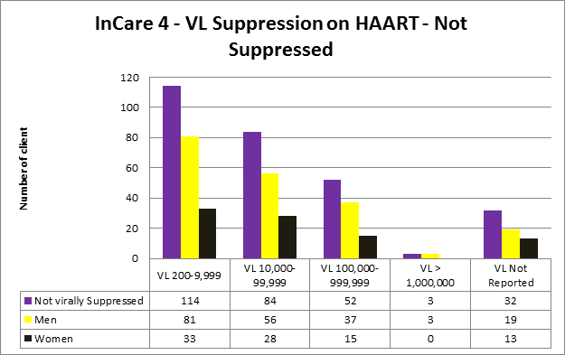
EAST CAROLINA UNIVERSITY BRODY SCHOOL OF MEDICINE
Performance Measure: Viral Load Suppression
Percentage of patients, regardless of age, with a diagnosis of HIV/AIDS with viral load below 200 during the measurement year 7/2012 thru 6/2013
Quality Improvement Increase the number of individuals Viral Load Suppressed within serviced population
PDSA | Implementation
Plan-Identify clients on ART who are not VL suppressed | CAREWare data reviewed by QI team;
Do-Chart reviews/client interviews to identify barriers | EMR chart reviews conducted by QI team; developed brief phone screening tool to assess barriers according to knowledge and adherence; designate MCC screened 11 clients w/high VL in June 2013
Study-Present results/ plan QM team-develop process for change | Results: Clients had multiple barriers and need help and referrals to address barriers
Action-Implement Plan/review previous PDSA’s/present to QM group & develop new PDSA cycle | A process was developed to refer clients to members of the TAT to address client’s barriers (LRC, BHC, MCC, and MACC); A designate MCC was assigned to assess and develop ISP for client that are on HARRT and not VL suppressed; team will continue w/chart review and making contact with clients not VL suppressed.
LRC-Linkage Retention Coordinator MCC-Medical Care Coordinator
BHC –Behavioral Health Coordinator MACC-Medication Adherence Clinical Coordinator
TAT – Treatment Adherence Team ISP - Individual Service Plan

