Slide 1

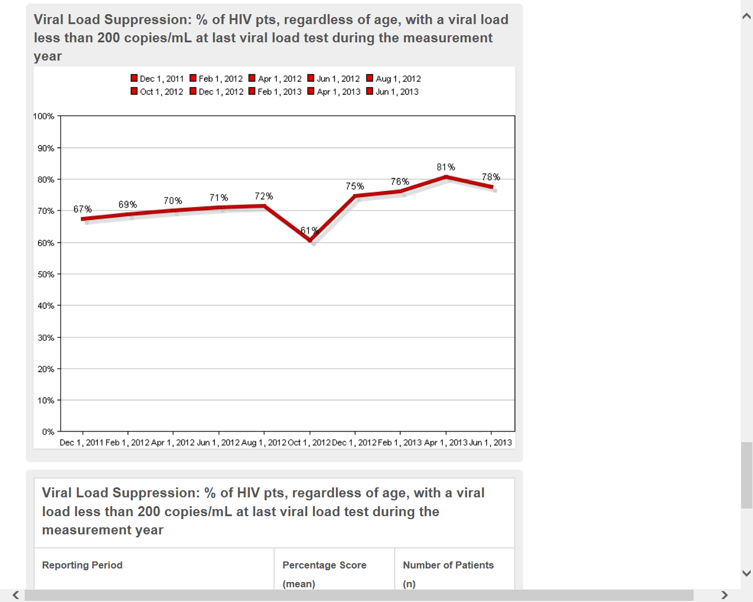
Carolina Family Health Centers In+care 04-Viral Load Suppression
80 NEW CLIENT ENROLLED INTO MEDICAL CARE DURING FISCAL YEAR
14 were viral load suppressed.
54 which were previously diagnosed and are returning to medical care.
11 transferred care
1 incarcerated
REINFORCEMENT ABOUT TREATMENT ADHERNCE
Medical providers: start treatment immediately
Pharmacist: assessment for readiness of medication regimen
ADAP specialist: immediately assist all uninsured patient with ADAP
Peer educator: Provides patients/families with information
on HIV/AIDS in our new client package .
Case managers: Making sure that the client’s medical as well as holistic needs are being met.
80 new patient. During the time frame

